Slide 1


SIMATS ENGINEERING
SAVEETHA INSTITUTE OF MEDICAL AND TECHNICAL SCIENCES
Data Preprocessing and Visualization Using Pandas and Matplotlib
DSA04 – Fundamentals of Data Science
Guided by:
Dr. Krishnaraj Mony
Associate Professor/CSE
Presented by: A.Reddy Prasad(192472045)

Slide 2


INTRODUCTION
Data preprocessing is the process of cleaning, organizing, and transforming raw data into a usable format for analysis.
Raw data often contains missing values, duplicate records, incorrect formats, and inconsistencies, which can affect the accuracy of analysis.
Data preprocessing improves data quality, reliability, and consistency, leading to better analytical results.
Pandas is a powerful Python library used for data manipulation and preprocessing.
Pandas provides two main data structures:
Series – One-dimensional labeled data.
DataFrame – Two-dimensional tabular data.

Slide 3
Essential Pandas Operations: Cleaning C Structuring Data
Pandas is a powerful Python library used for data cleaning, manipulation, and analysis.
Data cleaning is the process of identifying and correcting errors, inconsistencies, and missing values in a dataset.
Data structuring organizes data into a consistent and meaningful format for easy analysis.
Pandas provides the DataFrame structure, which stores data in rows and columns similar to a spreadsheet or database table.
Cleaning data improves the accuracy, reliability, and quality of data analysis.

Slide 4

Case Study 1: Customer Sales Data Cleaning with Pandas
Step 1 — Load & Inspect
Load the dataset using pd.read_csv().
Examine the dataset using df.head(), df.info(), and df.describe().
Identify missing values using df.isnull().sum().
Step 2 — Clean Missing Values
Fill missing customer names with "Unknown".
Replace missing purchase amounts with the median purchase value.
Remove rows with missing Customer IDs.
Step 3 — Remove Duplicates & Standardize
Remove duplicate customer records using drop_duplicates().
Convert city names to a consistent format using:

Slide 5
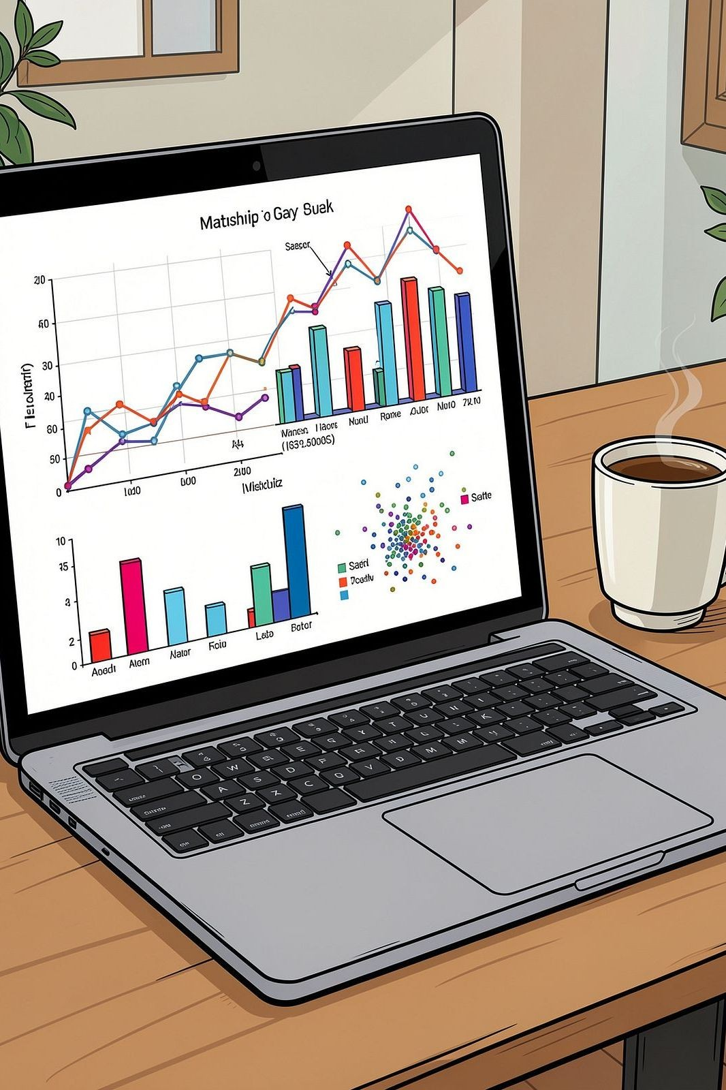
Introduction to Matplotlib: Bringing Your Data to Life
Matplotlib is a popular Python library used for creating graphs, charts, and visualizations.
It helps transform raw numerical data into meaningful visual representations, making data easier to understand.
Matplotlib is widely used in data science, machine learning, business analytics, engineering, and scientific research.
It provides a simple interface for creating both basic and advanced visualizations.
Matplotlib works seamlessly with Pandas and NumPy for data analysis and plotting.

Slide 6
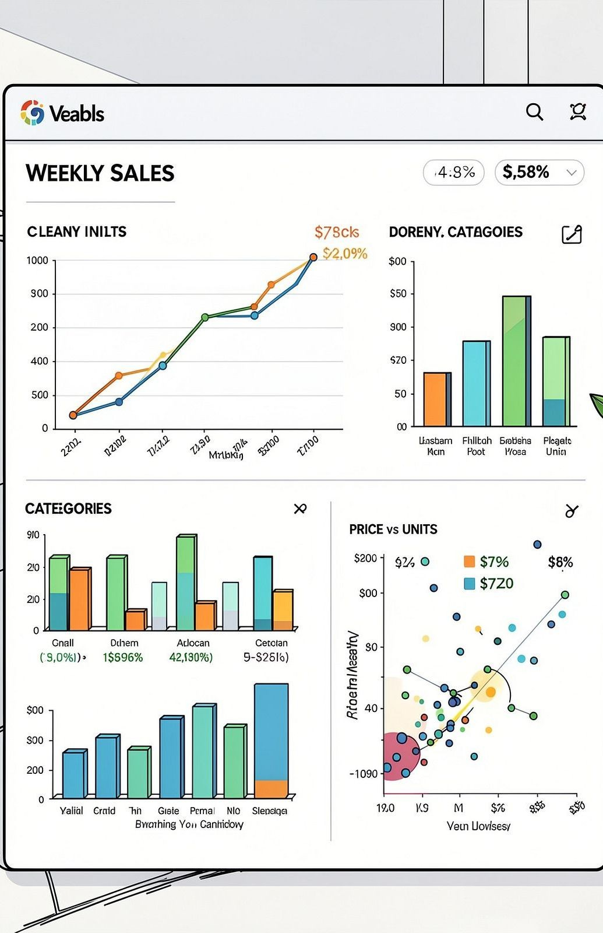
Case Study 2: Visualising Cleaned Data for Impact
Step 1 — Load the Cleaned Dataset
Load the cleaned dataset using pd.read_csv().
Verify the data using df.head() and df.info().
Step 2 — Prepare Data for Visualization
Convert the order_date column to datetime format.
Group sales data by week and product category.
Calculate total sales and total orders.
Step 3 — Create Visualizations
Plot a Line Chart to show weekly sales trends.
Plot a Bar Chart to compare sales across product categories.
Plot a Pie Chart to display each category's contribution to total sales.
Step 4 — Analyze & Interpret
Identify weeks with the highest and lowest sales.
Compare the performance of different product categories.

Slide 7
CONCLUSION
Pandas is a powerful Python library that simplifies data cleaning, preprocessing, and manipulation tasks.
Matplotlib enables users to create meaningful and visually appealing charts for effective data analysis.
Data preprocessing improves the accuracy, consistency, and quality of datasets by handling missing values, duplicates, and incorrect formats.
Data visualization helps identify patterns, trends, relationships, and outliers, making complex data easier to understand.
The combination of Pandas and Matplotlib provides a complete workflow for preparing and visualizing data efficiently.
Clean and well-structured data leads to more reliable analysis and better decision-making.

Slide 8
THANK YOU

